Slide 1
Peace Quilt
Covington High School
Covington, VA, USA

Slide 2
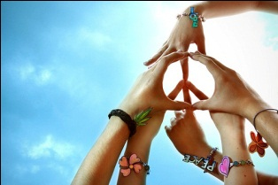
Mrs. Zeek

Slide 3

Faith

Slide 4

Caitlin

Slide 5

Ryan

Slide 6

Burke

Slide 7

Kelley

Slide 8

Hayden

Slide 9
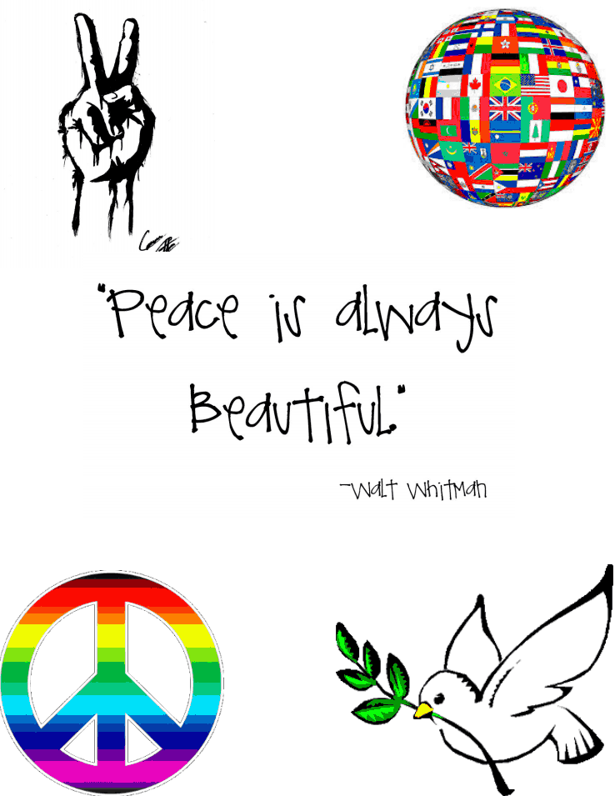
Karie

Slide 10

Allison

Slide 11

Mahaley

Slide 12

Emily

Slide 13

Brian

Slide 14

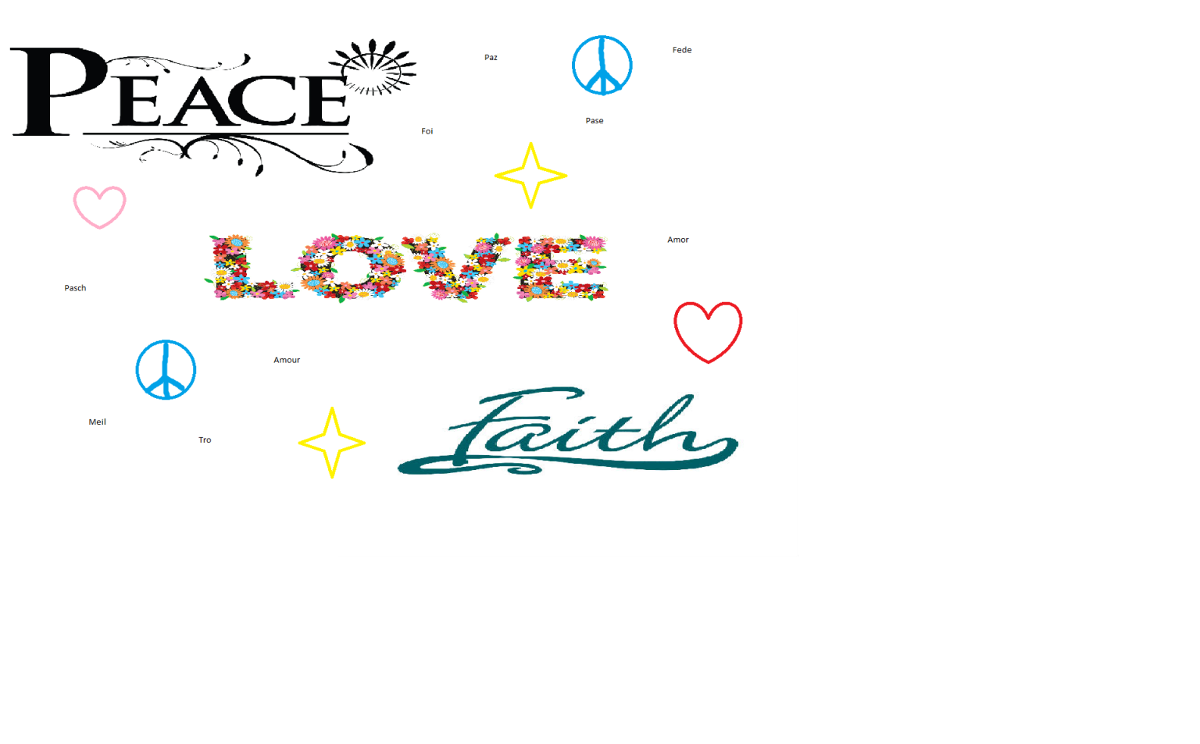
Kim

Slide 15

Trey

Slide 16

Shermaine

Slide 17


